Slide 1
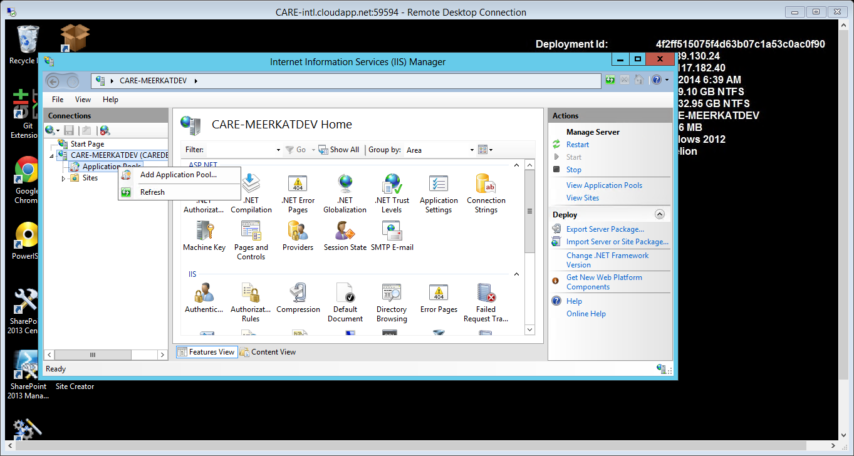
Right click on Application pools and from the menu select “Add Application pool”.

Slide 2
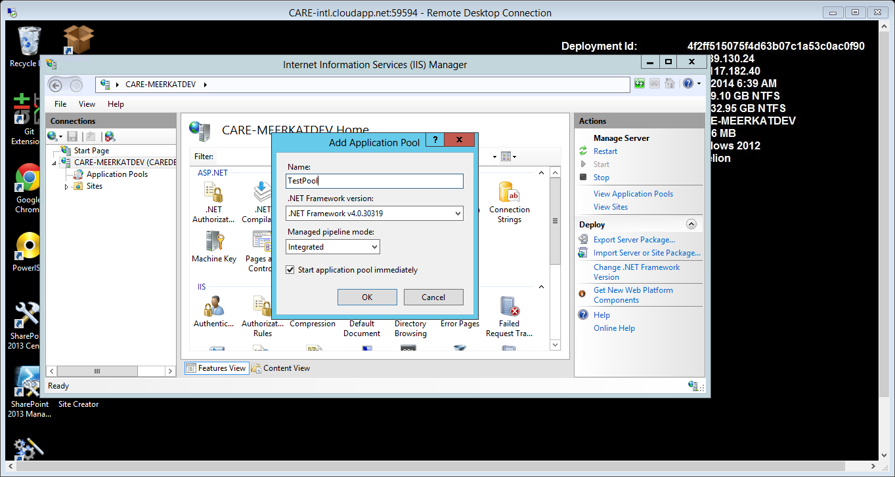
Provide a name for the application pool and click ok to create it. Depending on the requirements the .NET Framework and managed pipeline mode can be changed, but in most cases and more so for Meerkat, we use the defaults.

Slide 3
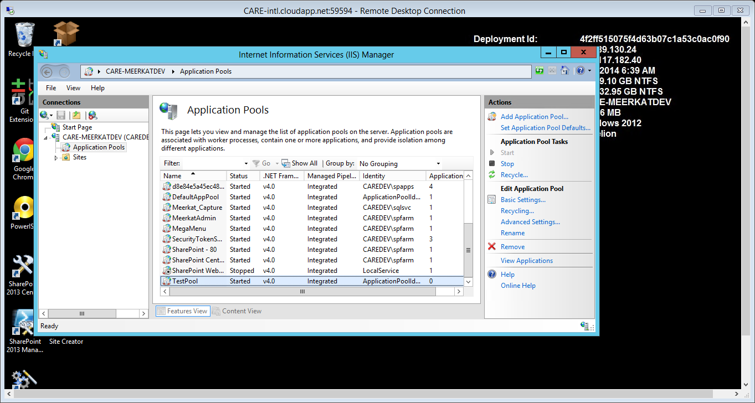
Click on the application pools at the left then select the Application pool you created and click on Advanced Settings for configuration.

Slide 4
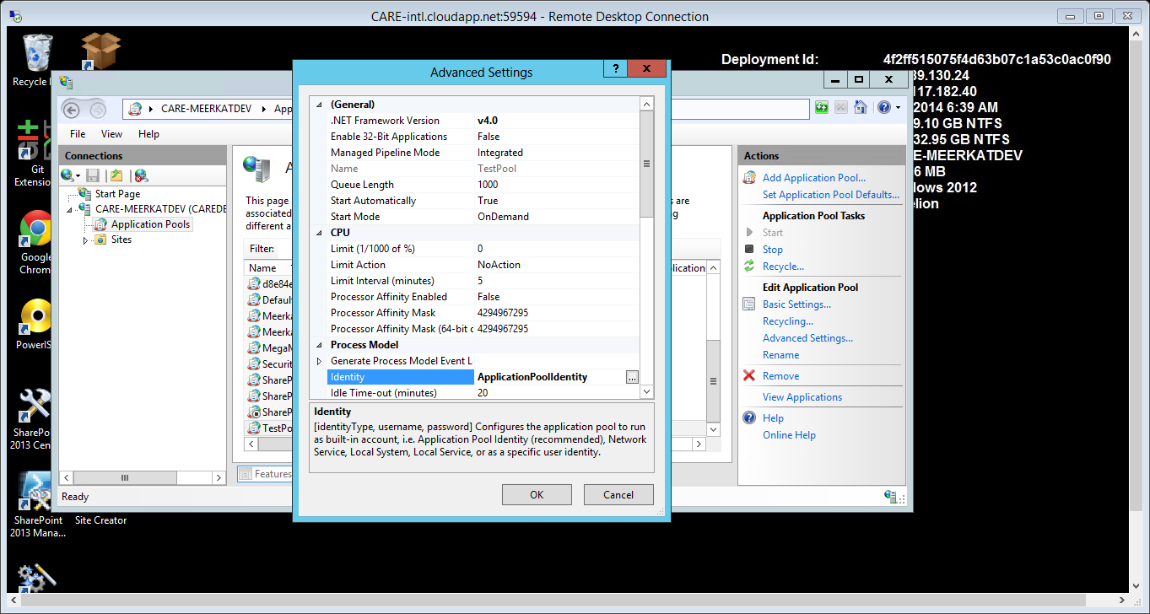
Select the identity section and click on the ellipsis to the right.

Slide 5
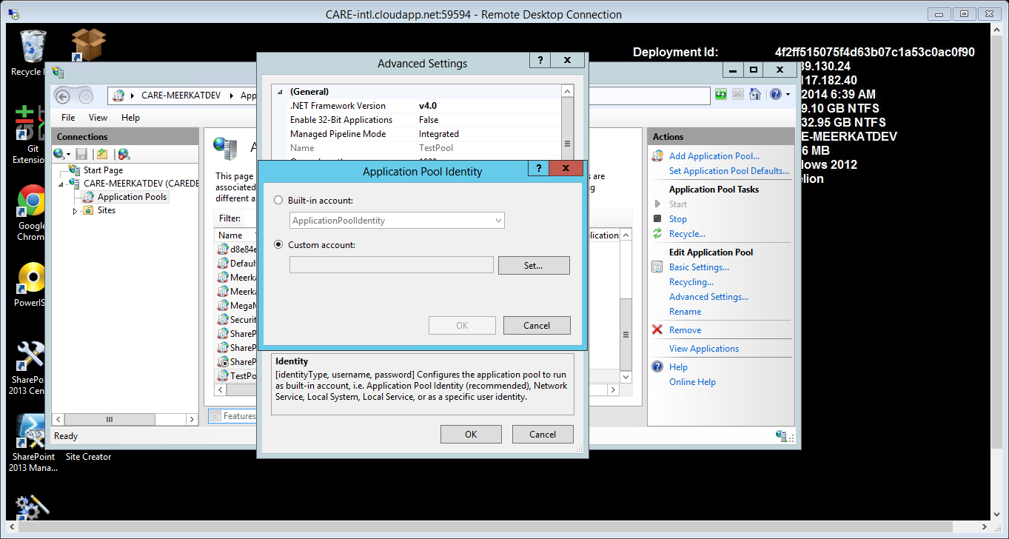
Select the Custom Account option and then click Set to enter the details.

Slide 6
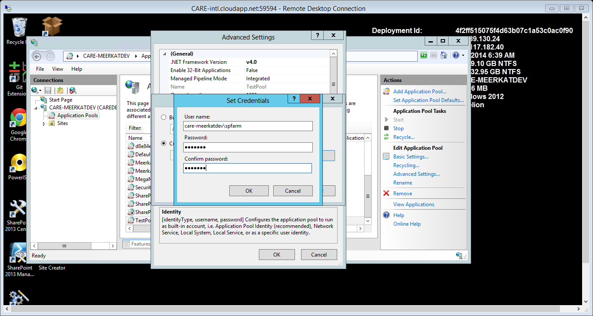

Provide the domain username with access to the Meerkat DB and enter the corresponding password then click ok.

Slide 7


Slide 8
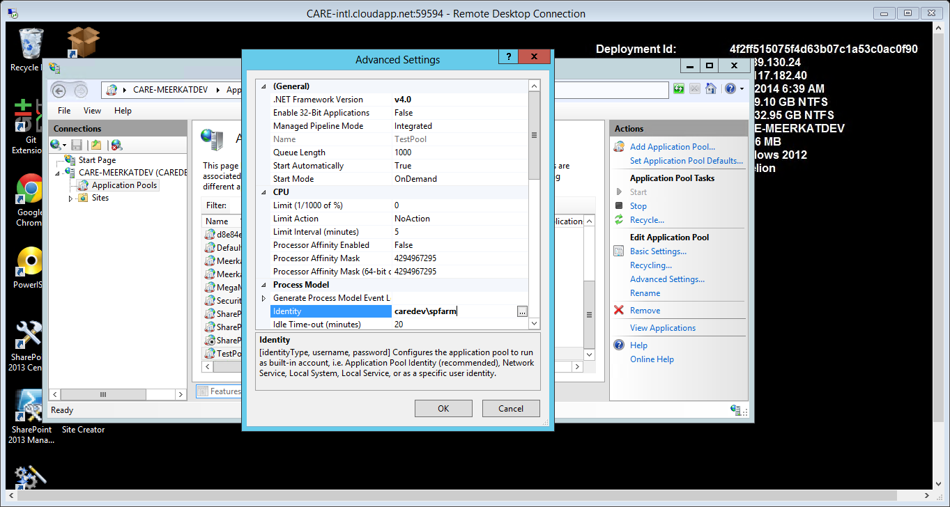
Confirm the new application pool identity and click ok to exit.

Slide 9
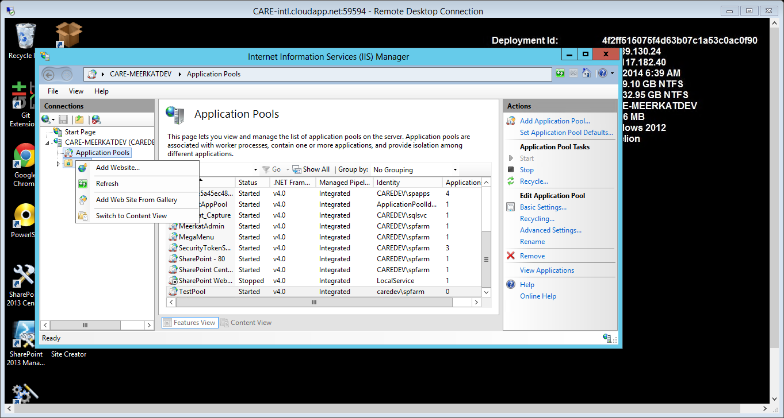
In the left Menu, right click on sites and from the resultant menu, click “Add Website”.

Slide 10
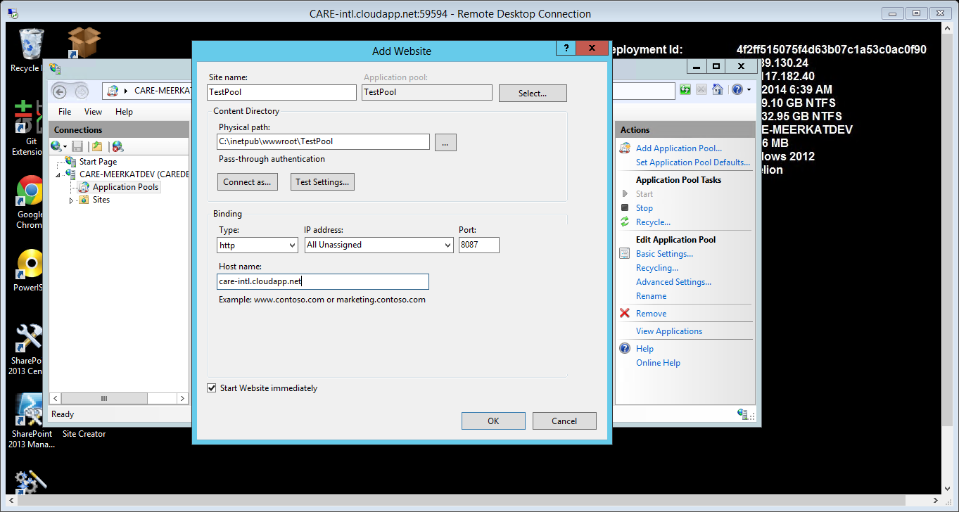
Provide the site name and if the application pool name is different, change it by clicking on the select button. Afterwards, provide the physical path, test the settings and then provide the port for the site and the host name then click ok.
NB: The physical path should point to an already existing directory.

Slide 11
